Slide 1
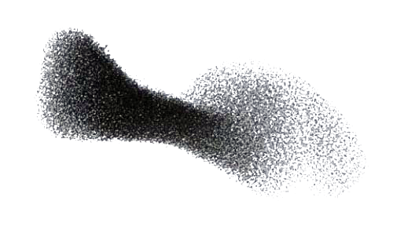
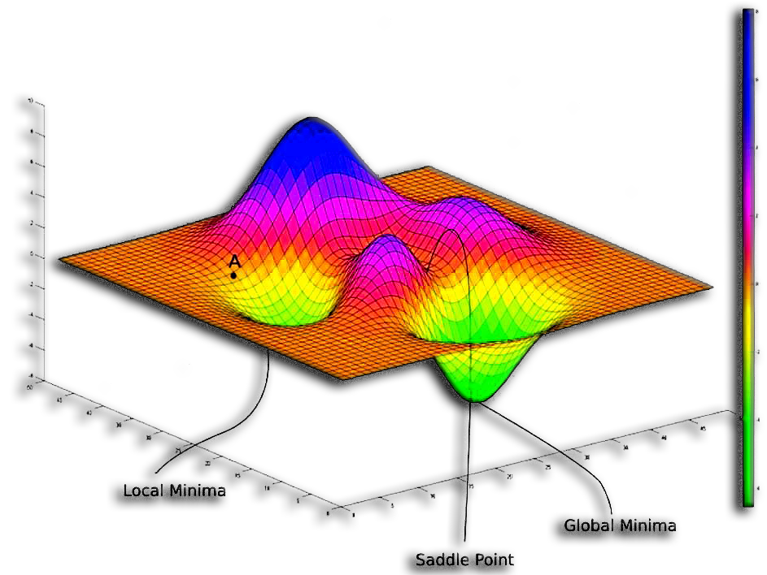
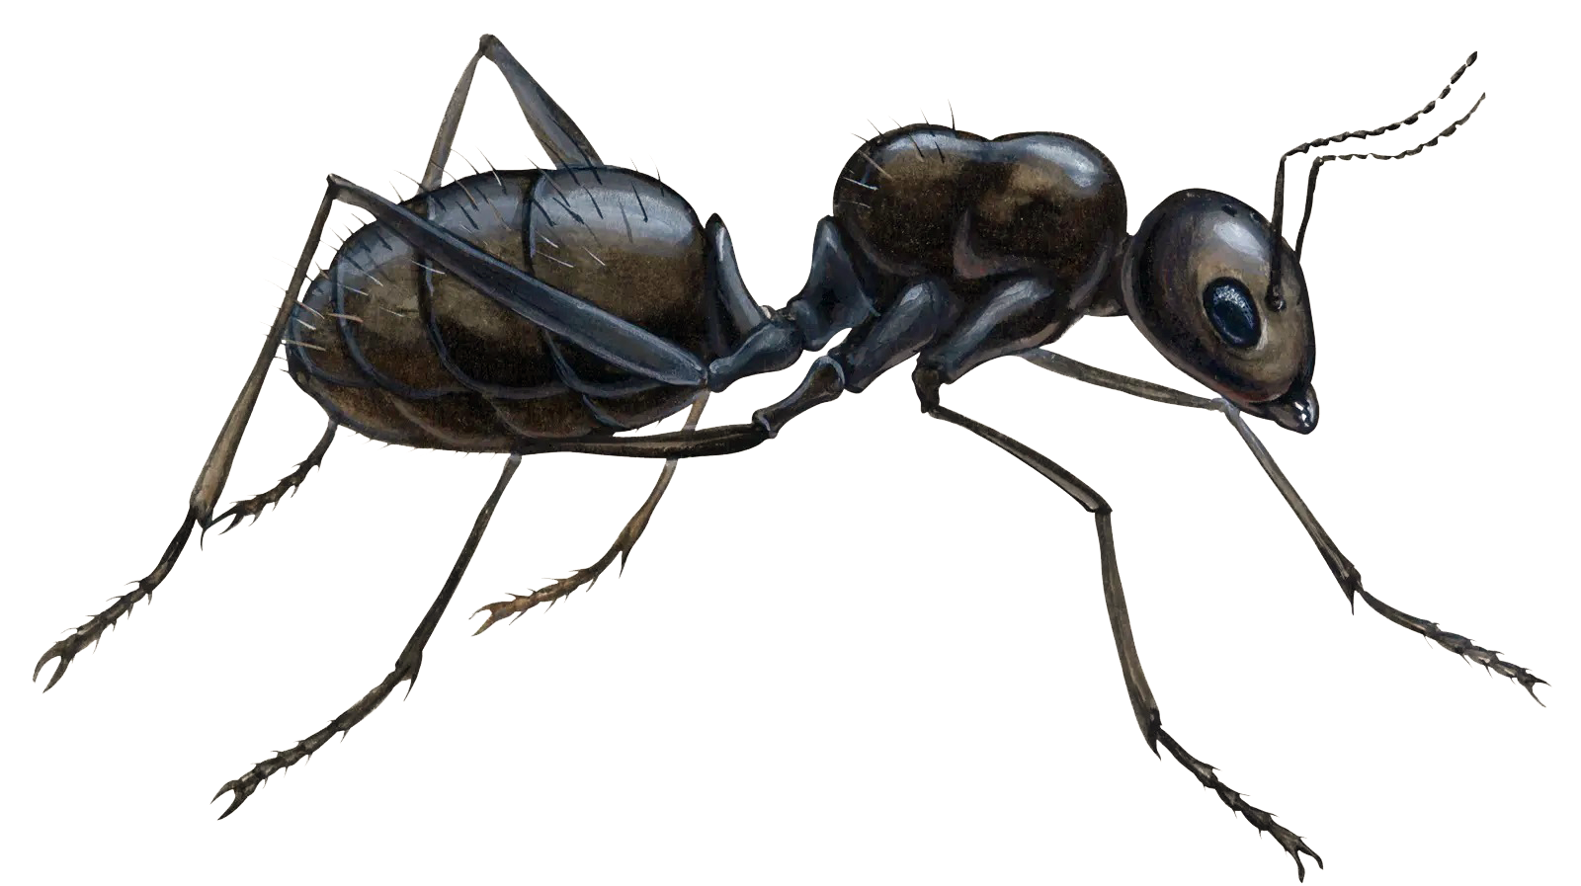
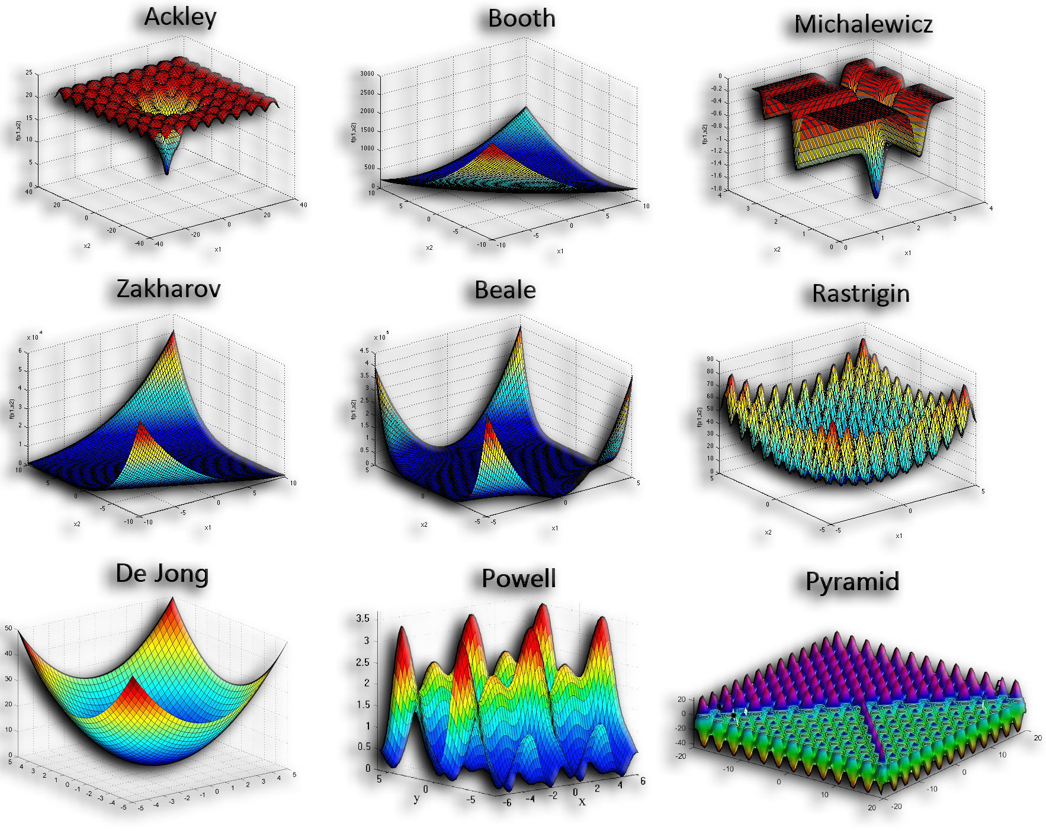
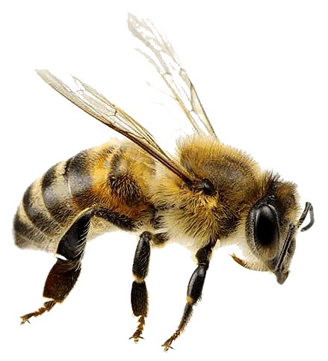

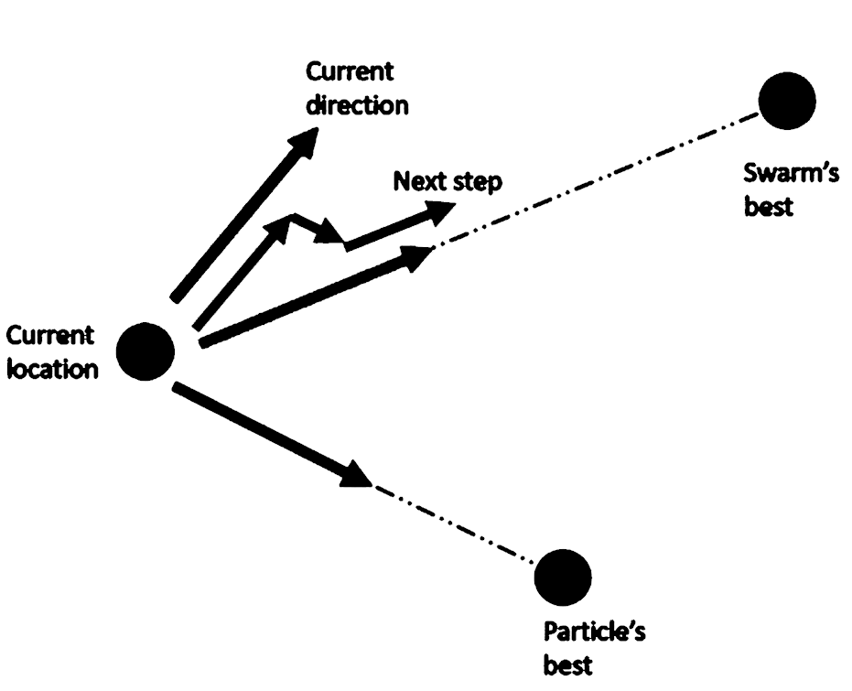
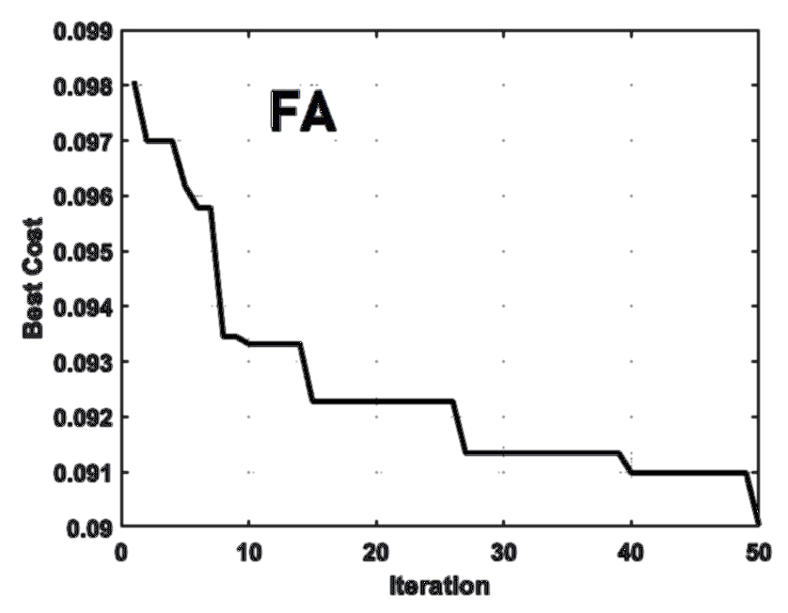
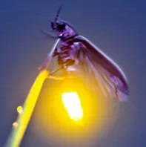
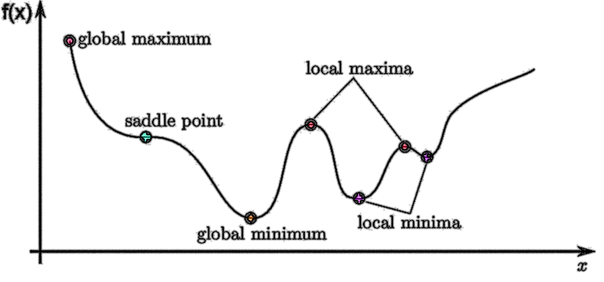

Metaheuristic Optimization: 4 Cutting-Edge Applications
Evolved Antenna Design by Particle Swarm Optimization algorithm (PSO)
By: Seyed Muhammad Hossein Mousavi
2025

Slide 2

Outline:
Optimization
Optimization Problems
Protein Folding by Differential Evolution algorithm (DE)
Space-Time Warping by Firefly Algorithm (FA)
Exoplanetary Adaptation Simulation by Genetic Algorithm (GA)
Evolved Antenna Design by Particle Swarm Optimization (PSO) algorithm

Slide 3

Optimization Problems
Evolved Antenna Design by Particle Swarm Optimization algorithm (PSO)
Antenna: A device that transmits or receives electromagnetic waves by converting electrical signals into radio waves and vice versa.
Evolved Antenna: An antenna whose shape or geometry is automatically optimized using evolutionary algorithms instead of manual design.
Optimization: The process of adjusting design variables to achieve the best possible performance under given constraints.
Objective Function: A mathematical formula that measures how good or bad the antenna design is. Here, lower values mean better performance.
Particle Swarm Optimization (PSO): A nature-inspired algorithm that simulates the collective behavior of birds or fish to find optimal solutions.
Particle: A single candidate solution in PSO representing one possible antenna geometry.

Slide 4
Optimization Problems
Evolved Antenna Design by Particle Swarm Optimization algorithm (PSO)
Swarm: A group of particles exploring the search space together, sharing information to find the best solution.
Fitness / Cost: A numerical score computed by the objective function that determines how good each antenna design is.
Iteration: One full update cycle where all particles adjust their positions and velocities based on personal and global bests.
Global Best (gbest): The best solution (antenna design) found by the entire swarm up to the current iteration.
Personal Best (pbest): the best antenna design found by one specific particle so far.
Inertia Weight (w): A coefficient controlling how much of the previous velocity a particle keeps in the next iteration (balances exploration/exploitation).

Slide 5
Optimization Problems
Evolved Antenna Design by Particle Swarm Optimization algorithm (PSO)
Cognitive Component (c1): A PSO parameter that makes each particle move toward its own best-known position.
Social Component (c2): A PSO parameter that makes each particle move toward the swarm’s best-known position.
Velocity: The rate of change of a particle’s position determines how fast and in which direction it moves through the search space.
Search Space: The multidimensional region containing all possible antenna designs that PSO explores.
Convergence: The stage when all particles gradually move toward the same best solution.
Bending Penalty: A penalty term that discourages sharp bends or irregularities in the antenna’s 3D path.
Euclidean Distance: The straight-line distance between two points in 3D space, used to measure antenna segment lengths.

Slide 6
Optimization Problems
Evolved Antenna Design by Particle Swarm Optimization algorithm (PSO)
The objective function:
It tells the PSO which antenna design is better; shorter and smoother antennas get lower cost values and are considered better.
It calculates the total length of the antenna by summing all the distances between consecutive joints.
Shorter antennas are better because they use less material.
Adds a penalty for sharp vertical bends by checking how much the z-coordinate changes between points; smoother antennas get a lower penalty.

Slide 7
Optimization Problems
Evolved Antenna Design by Particle Swarm Optimization algorithm (PSO)
Why antenna design matters?
Antennas directly control how efficiently wireless systems transmit and receive signals, affecting everything from communication range to power use.
Why use metaheuristics like PSO?
Traditional formula-based or manual designs struggle with complex, nonlinear 3-D geometries where analytical optimization is impossible.
Why is PSO better in this context?
PSO efficiently searches vast design spaces without requiring gradients, balancing exploration and exploitation to discover high-performance antenna shapes automatically.

Slide 8
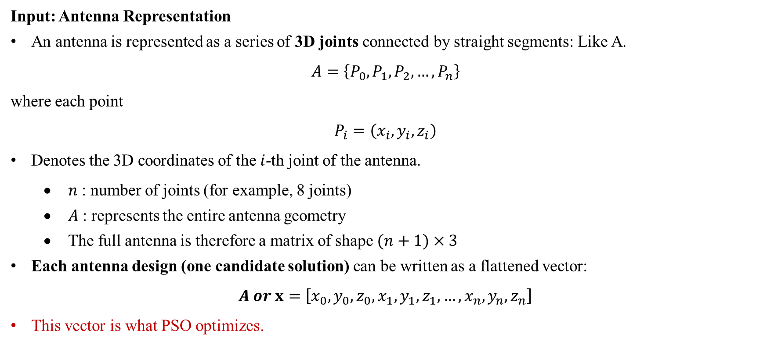
Optimization Problems
Evolved Antenna Design by Particle Swarm Optimization algorithm (PSO)
Input: Antenna Representation
An antenna is represented as a series of 3D joints connected by straight segments: Like A.
$$A=\left\{P_{0},P_{1},P_{2},…,P_{n}\right\}$$
where each point
$$P_{i}=\left(x_{i},y_{i},z_{i}\right)$$
Denotes the 3D coordinates of the $i$-th joint of the antenna.
$n$ : number of joints (for example, 8 joints)
$A$ : represents the entire antenna geometry
The full antenna is therefore a matrix of shape $(n+1)×3$
Each antenna design (one candidate solution) can be written as a flattened vector:
$$A or x=\left[x_{0},y_{0},z_{0},x_{1},y_{1},z_{1},…,x_{n},y_{n},z_{n}\right]$$
This vector is what PSO optimizes.

Slide 9
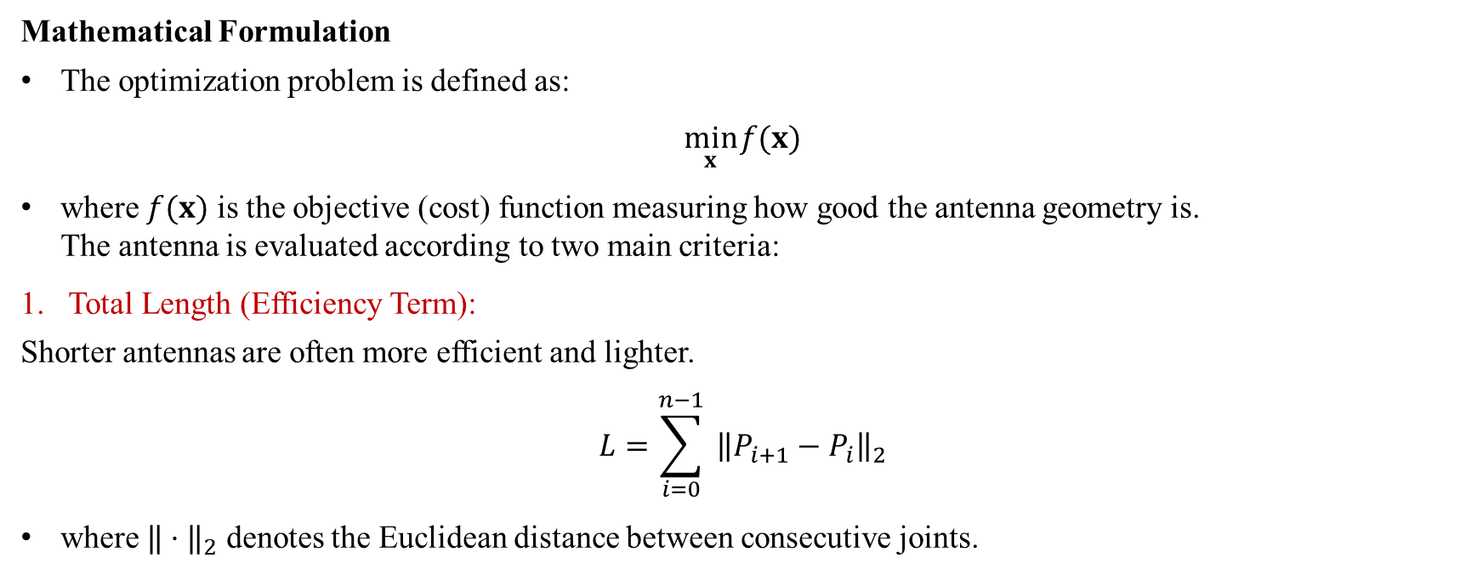
Optimization Problems
Evolved Antenna Design by Particle Swarm Optimization algorithm (PSO)
Mathematical Formulation
The optimization problem is defined as:
$$\min_{x} f(x)$$
where $f(x)$ is the objective (cost) function measuring how good the antenna geometry is. The antenna is evaluated according to two main criteria:
Total Length (Efficiency Term):
Shorter antennas are often more efficient and lighter.
$$L=\sum_{i=0}^{n−1}{ }{\left\|P_{i+1}−P_{i}\right\|}_{2}$$
where $‖⋅‖_{2}$ denotes the Euclidean distance between consecutive joints.

Slide 10
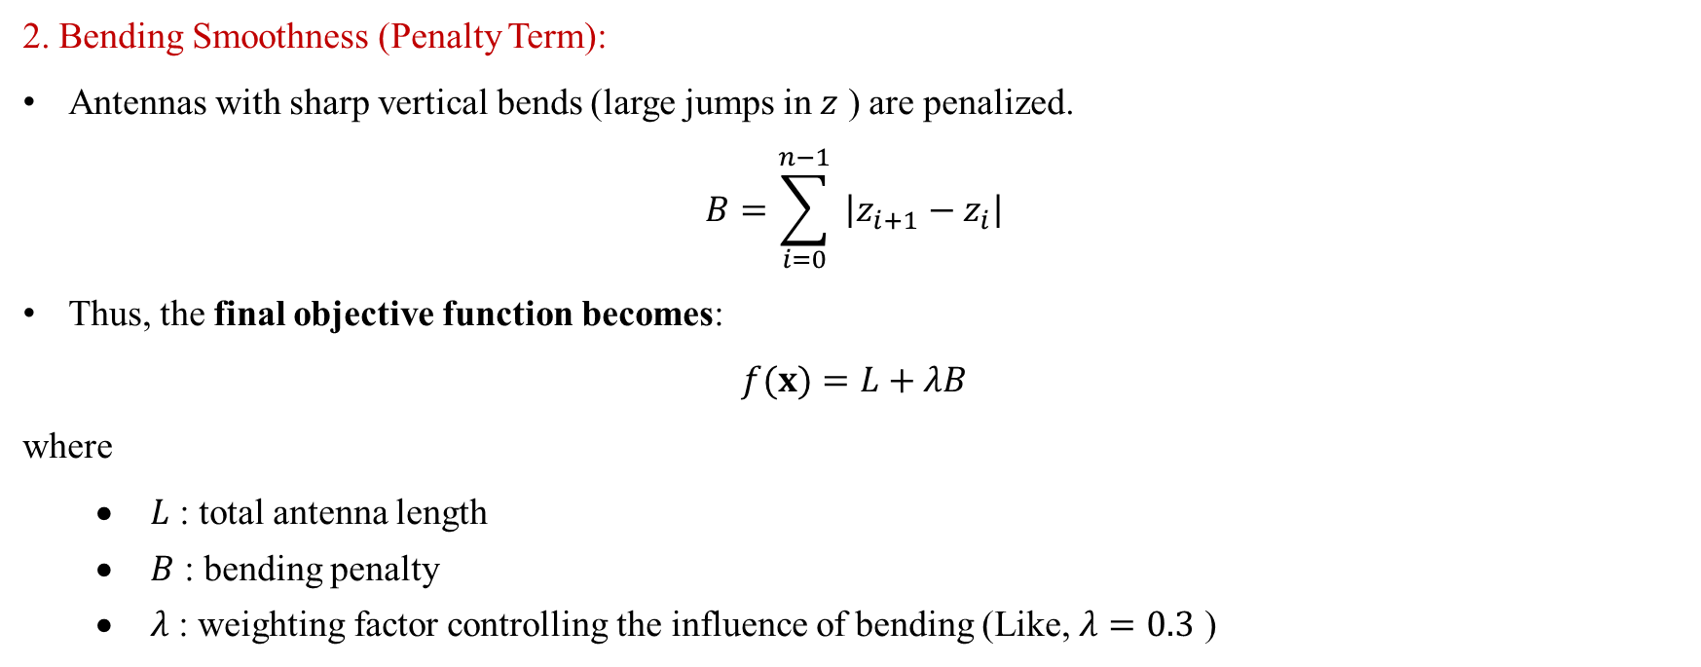
Optimization Problems
Evolved Antenna Design by Particle Swarm Optimization algorithm (PSO)
2. Bending Smoothness (Penalty Term):
Antennas with sharp vertical bends (large jumps in $z$ ) are penalized.
$$B=\sum_{i=0}^{n−1}{ }\left|z_{i+1}−z_{i}\right|$$
Thus, the final objective function becomes:
$$f(x)=L+λB$$
where
$L$ : total antenna length
$B$ : bending penalty
$λ$ : weighting factor controlling the influence of bending (Like, $λ=0.3$ )

Slide 11
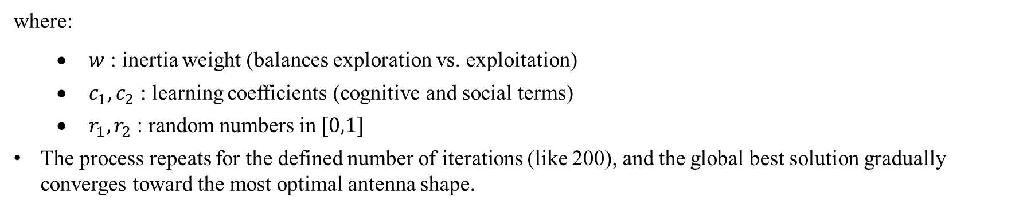
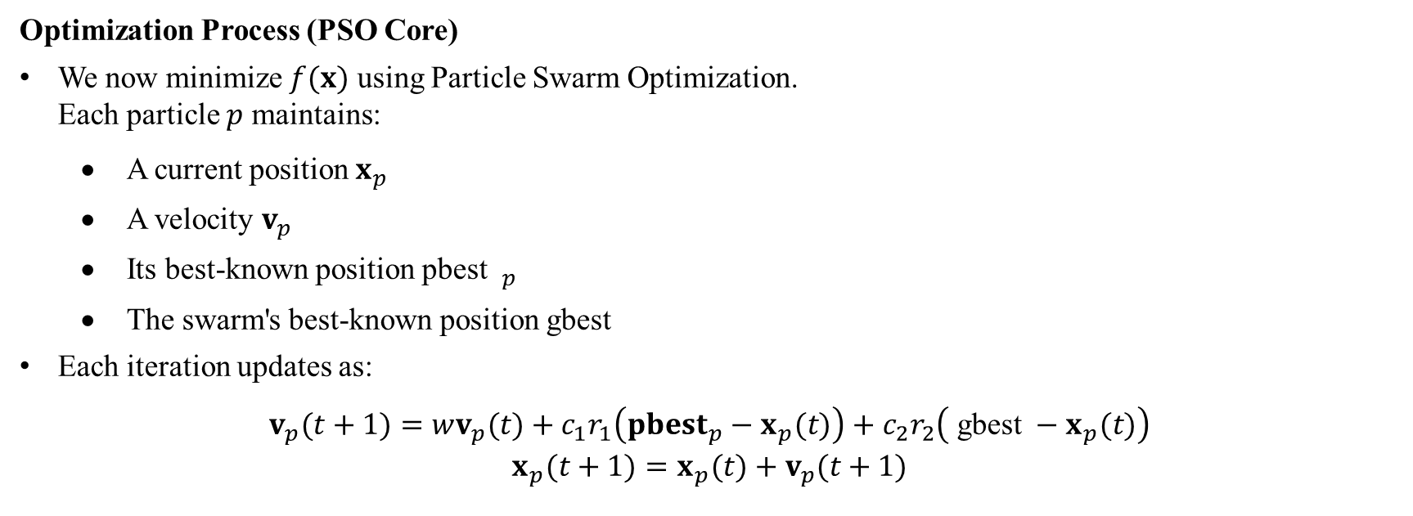
Optimization Problems
Evolved Antenna Design by Particle Swarm Optimization algorithm (PSO)
Optimization Process (PSO Core)
We now minimize $f(x)$ using Particle Swarm Optimization. Each particle $p$ maintains:
A current position $x_{p}$
A velocity $v_{p}$
Its best-known position pbest $_{p}$
The swarm's best-known position gbest
Each iteration updates as:
$$\begin{matrix}v_{p}(t+1)=wv_{p}(t)+c_{1}r_{1}\left({pbest}_{p}−x_{p}(t)\right)+c_{2}r_{2}\left( \text{gbest} −x_{p}(t)\right) \\ x_{p}(t+1)=x_{p}(t)+v_{p}(t+1)\end{matrix}$$
where:
$w$ : inertia weight (balances exploration vs. exploitation)
$c_{1},c_{2}$ : learning coefficients (cognitive and social terms)
$r_{1},r_{2}$ : random numbers in $[0,1]$
The process repeats for the defined number of iterations (like 200), and the global best solution gradually converges toward the most optimal antenna shape.

Slide 12
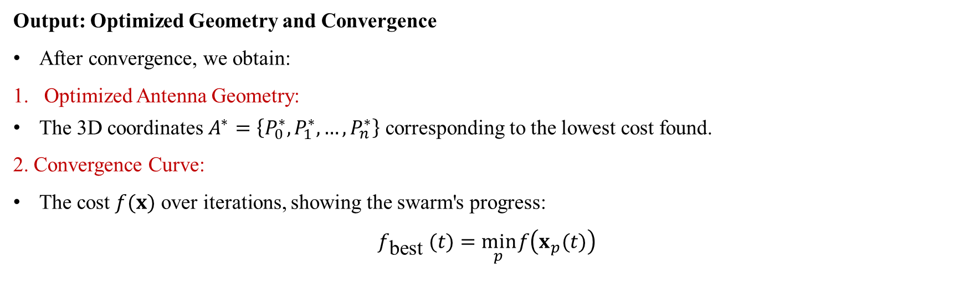
Optimization Problems
Evolved Antenna Design by Particle Swarm Optimization algorithm (PSO)
Output: Optimized Geometry and Convergence
After convergence, we obtain:
Optimized Antenna Geometry:
The 3D coordinates $A^{∗}=\left\{P_{0}^{∗},P_{1}^{∗},…,P_{n}^{∗}\right\}$ corresponding to the lowest cost found.
2. Convergence Curve:
The cost $f(x)$ over iterations, showing the swarm's progress:
$$f_{\text{best} }(t)=\min_{p} f\left(x_{p}(t)\right)$$

Slide 13
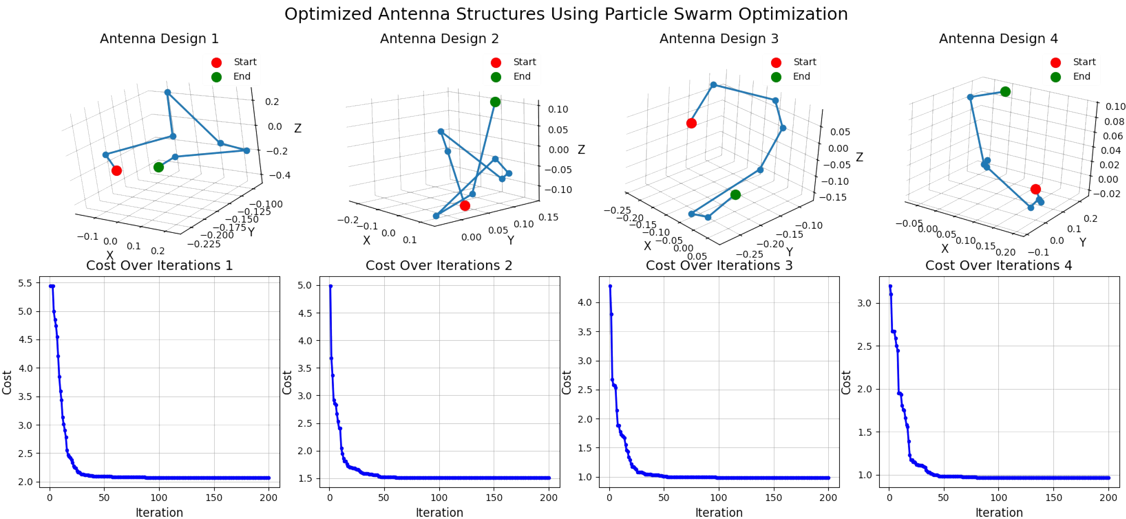
Optimization Problems
Evolved Antenna Design by Particle Swarm Optimization algorithm (PSO)

